Slide 1

Convergence Concepts
Dr. Justin Post
Xiaoxia Champon

Slide 2
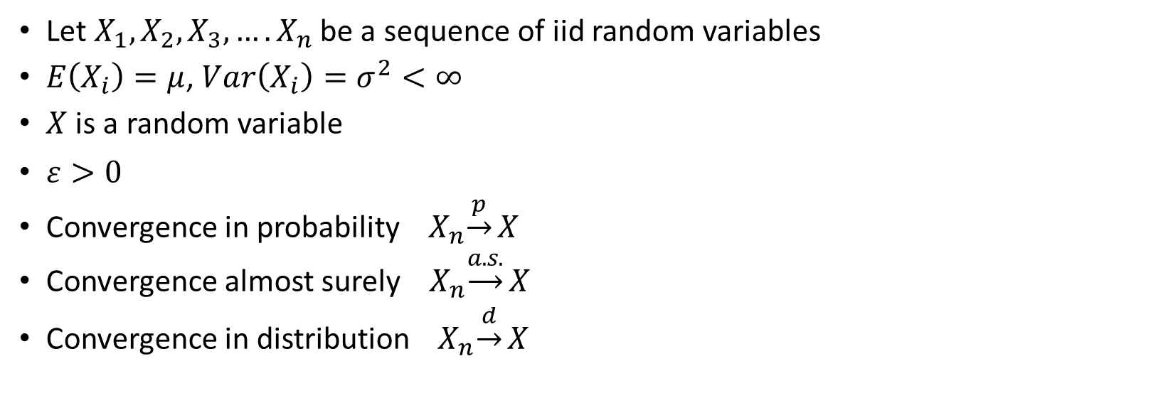
Notations
Let $X_{1}, X_{2}, X_{3},….X_{n}$ be a sequence of iid random variables
$E\left(X_{i}\right)=μ$, $Var\left(X_{i}\right)=σ^{2}<∞$
$X$ is a random variable
$ε>0$
Convergence in probability ${ X}_{n}\underset{→}{p}X$
Convergence almost surely ${ X}_{n}\underset{→}{a.s.}X$
Convergence in distribution ${ X}_{n}\underset{→}{d}X$

Slide 3

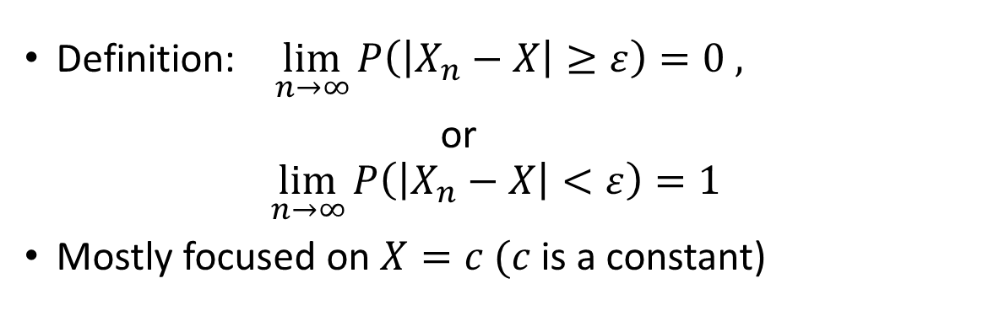

Convergence in probability ${ X}_{n}\underset{→}{p}X$
Definition: $\lim_{n→∞}{P\left(\left|X_{n}−X\right|≥ε\right)=0 , }$
or
$$\lim_{n→∞}{P\left(\left|X_{n}−X\right|<ε\right)=1 }$$
Mostly focused on $X=c (c$is a constant)
That’s great!
But what does that mean
?

Slide 4

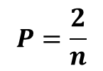


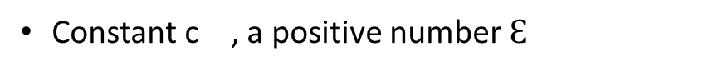
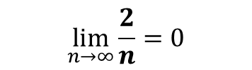
Thought process : $X_{n}\underset{→}{p}c$?
$\lim_{n→∞}{P\left(\left|X_{n}−c\right|≥ε\right)=0 }$
We have:
We also have:
$X_{1}, X_{2}, X_{3},….X_{n}$
Constant c , a positive number $Ɛ$
Find $d_{n}$=$X_{n}−c$ | $$d_{1}=X_{1}−c$$ | $d_{2}=X_{2}−c$ | $d_{3}=X_{3}−c$ | ... | $$d_{n}=X_{n}−c$$
Compare: $\left|d_{n}\right|≥Ɛ$ ?
 | $$\left|X_{1}−c\right|≥Ɛ$$ | $\left|X_{2}−c\right|$<$Ɛ$ | $$\left|X_{3}−c\right|≥Ɛ$$ | … | $\left|X_{n}−c\right|$<$Ɛ$
$$P=\frac{2}{n}$$
$$\lim_{n→∞}{\frac{2}{n}=0}$$
$$X_{n}\underset{→}{d}c$$

Slide 5
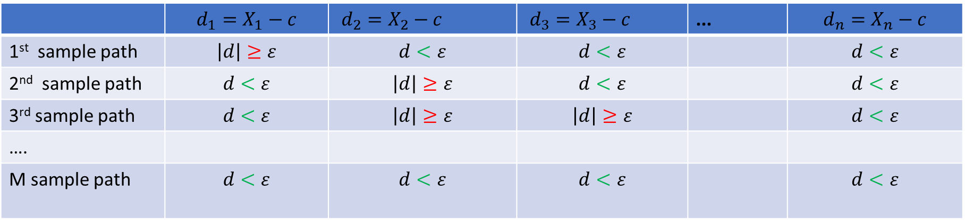
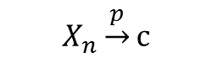

Let’s simulate this process M times
$\lim_{n→∞}{P\left(\left|X_{n}−c\right|≥ε\right)=0 }$
And find P for each column
 | $$d_{1}=X_{1}−c$$ | $d_{2}=X_{2}−c$ | $d_{3}=X_{3}−c$ | ... | $$d_{n}=X_{n}−c$$
1st sample path | $$\left|d\right|≥ε$$ | $$d<ε$$ | $$d<ε$$ |  | $$d<ε$$
2nd sample path | $$d<ε$$ | $$\left|d\right|≥ε$$ | $$d<ε$$ |  | $$d<ε$$
3rd sample path | $$d<ε$$ | $$\left|d\right|≥ε$$ | $$\left|d\right|≥ε$$ |  | $$d<ε$$
….
M sample path | $$d<ε$$ | $$d<ε$$ | $$d<ε$$ |  | $$d<ε$$
P | $$P_{1}=\frac{1}{M}$$ | $$P_{2}=\frac{2}{M}$$ | $$P_{3}=\frac{1}{M}$$ |  | $$P_{n}=0$$
$$\lim_{n→∞}P_{n}{=0}$$
$$X_{n}\underset{→}{p}c$$

Slide 6
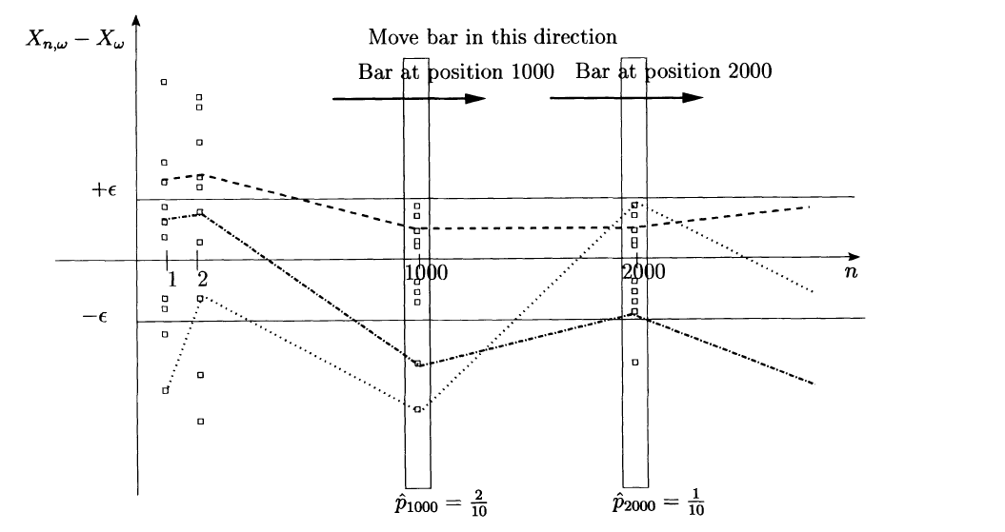
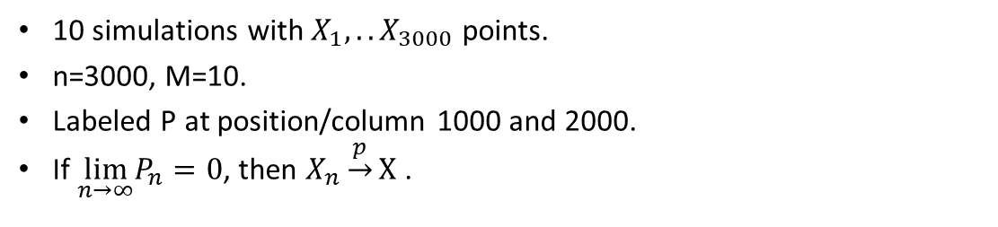

We are trying to observe $\lim_{n→∞}P_{n}$
10 simulations with $X_{1},..X_{3000}$ points.
n=3000, M=10.
Labeled P at position/column 1000 and 2000.
If $\lim_{n→∞}P_{n}{=0}$, then $X_{n}\underset{→}{p}X$ .

Slide 7
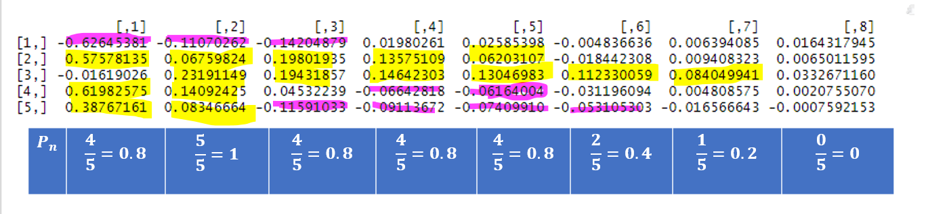
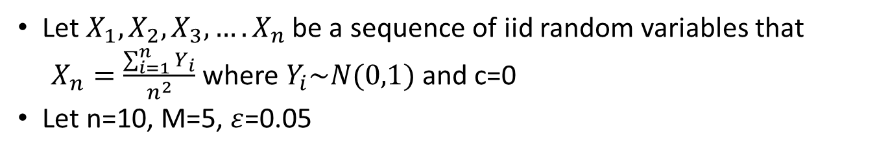
Example
Let $X_{1}, X_{2}, X_{3},….X_{n}$ be a sequence of iid random variables that
$X_{n}=\frac{\sum_{i=1}^{n}{Y_{i}}}{n^{2}}$ where $Y_{i}\sim N(0,1)$ and c=0
Let n=10, M=5, $ε$=0.05

Slide 8
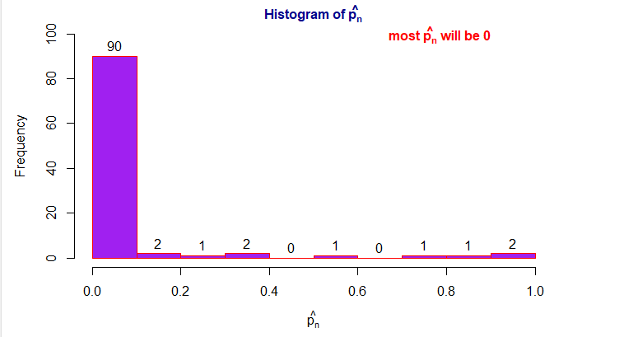
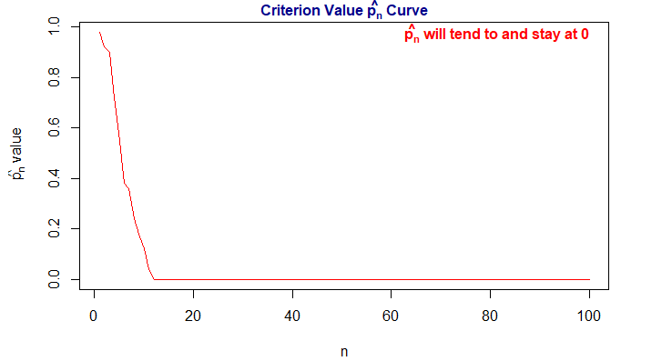

Let’s make n=100 and simulate M=50 times
$$\lim_{n→∞}P_{n}{=0} and{ X}_{n}\underset{→}{p}0$$

Slide 9
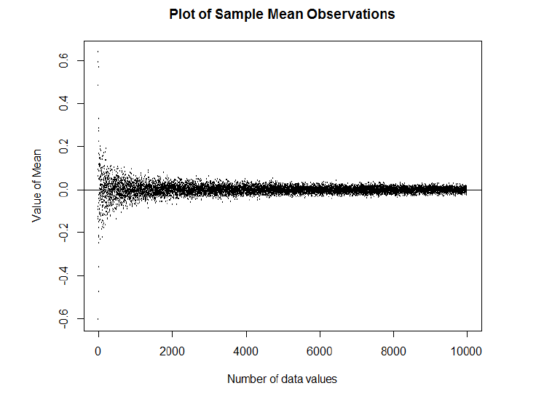

Weak Law of Large Numbers(WLLN)
Define $\overline{X}=\frac{1}{n}\sum_{i=1}^{n}{X_{i}}$
$E\left(X_{i}\right)=μ$, $Var\left(X_{i}\right)=σ^{2}<∞$
$\lim_{n→∞}{P\left(\left|\overline{X_{n}}−μ\right|>ε\right)=0}$
or
$\overline{X_{n}}\underset{→}{p}μ$
$$X_{n}\underset{→}{P}0 where X is random sampled from N(0,1)$$

Slide 10
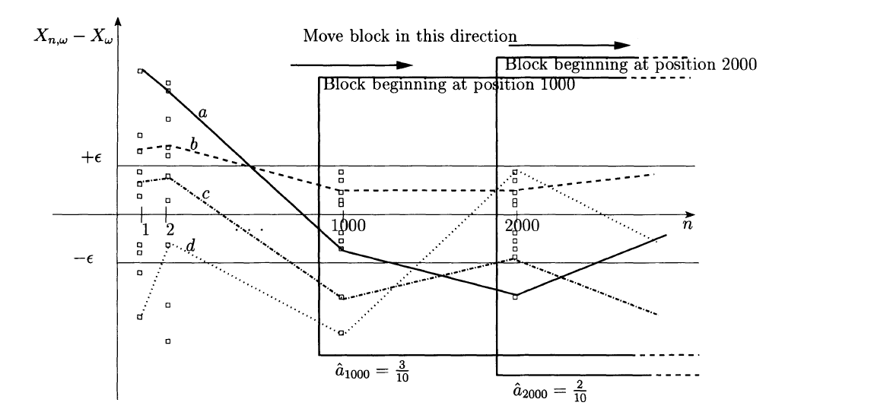

Differences between a.s. and in probability
In probability: Focused on points out of bound at position K
Almost surely: Focused on sample paths out of bound starting at position K

Slide 11
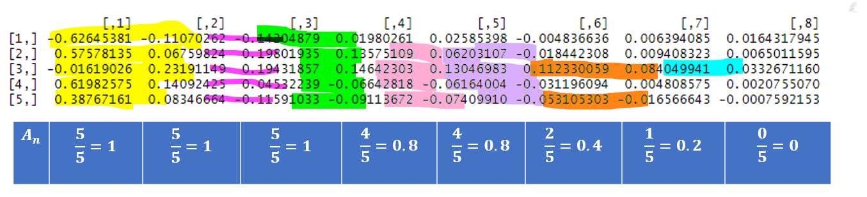
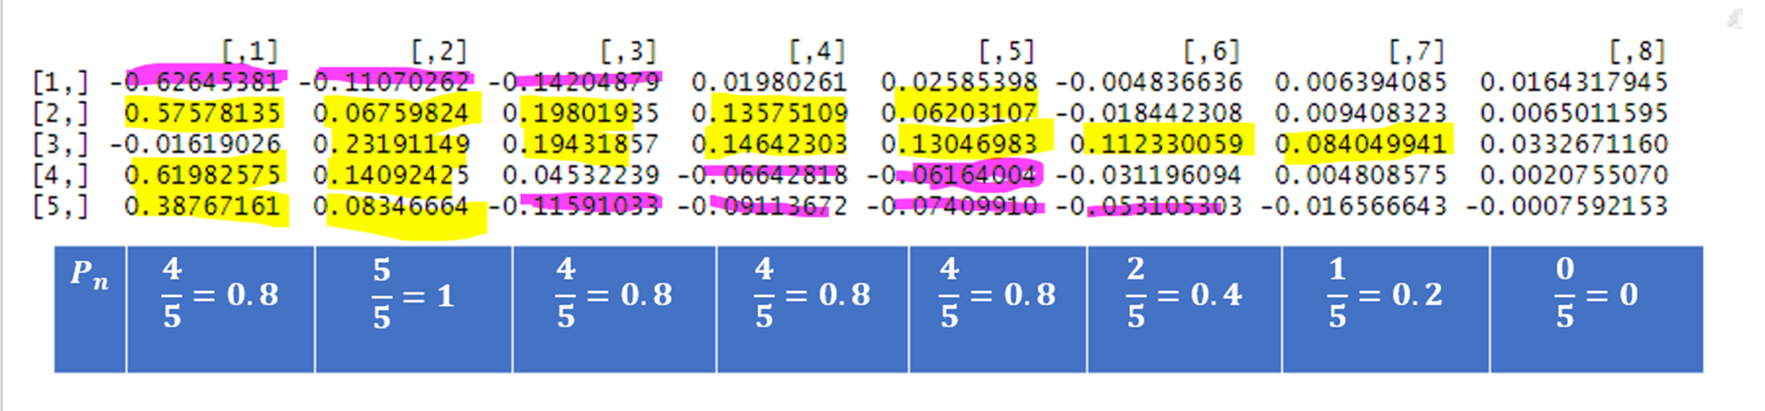
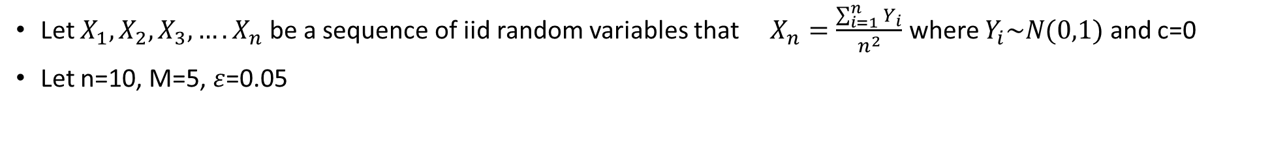
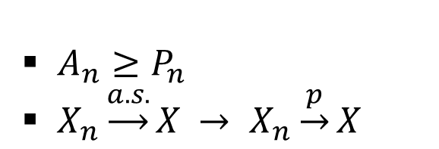
Same example from earlier
Let $X_{1}, X_{2}, X_{3},….X_{n}$ be a sequence of iid random variables that $X_{n}=\frac{\sum_{i=1}^{n}{Y_{i}}}{n^{2}}$ where $Y_{i}\sim N(0,1)$ and c=0
Let n=10, M=5, $ε$=0.05
$A_{n}≥P_{n}$
$X_{n}\underset{→}{a.s.}X$ $→ X_{n}\underset{→}{p}X$

Slide 12
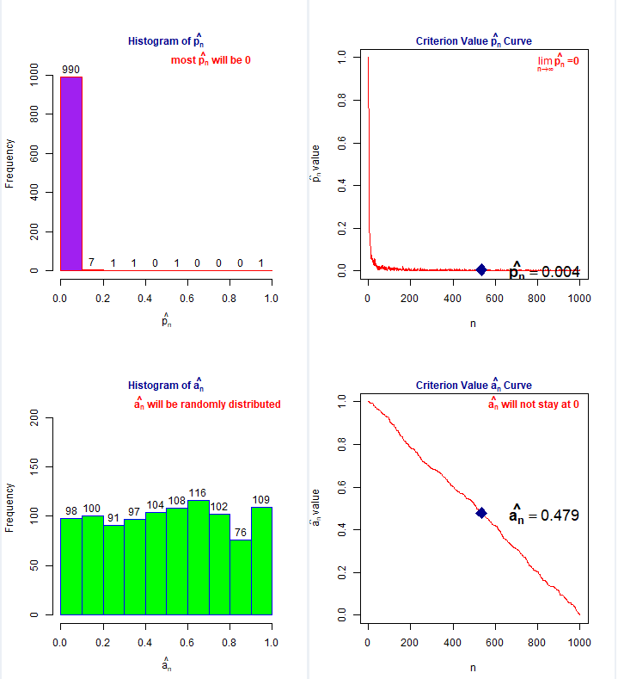

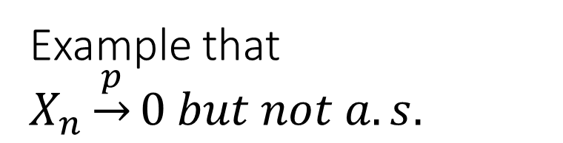
Example that $X_{n}\underset{→}{p}0 but not a.s.$
Let $X_{1}, X_{2}, X_{3},….X_{n}$ be a sequence of iid random variables that
$P\left[X_{n}=\sqrt{n}\right]=\frac{1}{n} and P\left[X_{n}=0\right]=1−\frac{1}{n}$
n=1000, M=500, $ε$=0.05

Slide 13

Strong Law of Large Numbers(SLLN)
Define $\overline{X}=\frac{1}{n}\sum_{i=1}^{n}{X_{i}}$
$E\left(X_{i}\right)=μ$, $Var\left(X_{i}\right)=σ^{2}<∞$
$P\left(\lim_{n→∞}\left|\overline{X_{n}}−μ\right|>ε\right)=0$
or
$\overline{X_{n}}\underset{→}{a.s.}μ$

Slide 14
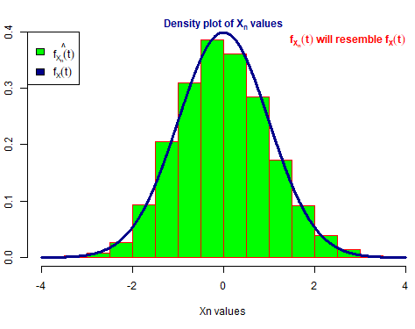
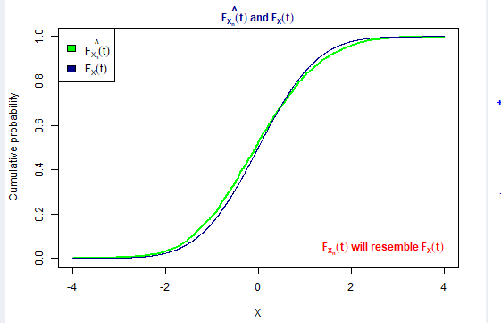

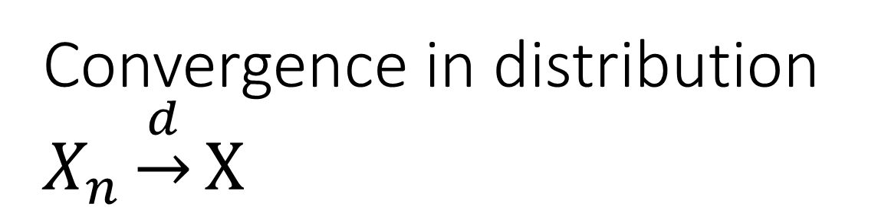
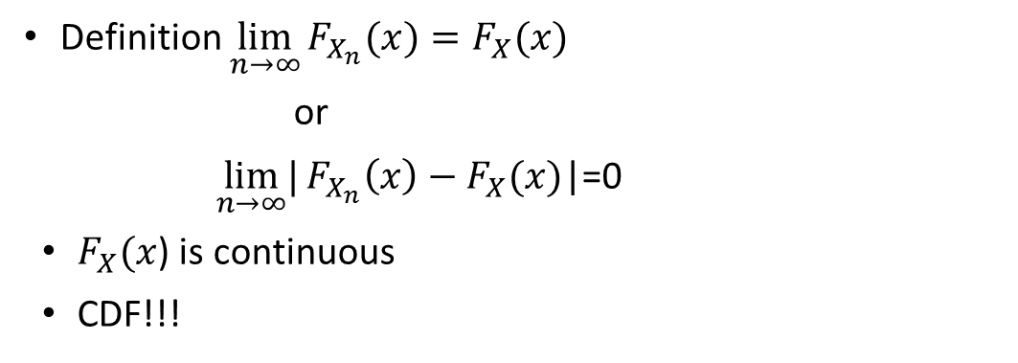
Convergence in distribution $X_{n}\underset{→}{d}X$
Definition $\lim_{n→∞}{F_{X_{n}}(x)=F_{X}(x)}$
or
$\lim_{n→∞}|{F_{X_{n}}\left(x\right)−F_{X}(x)}$|=0
$F_{X}(x$) is continuous
CDF!!!

Slide 15


Central Limit Theorem
Define $\overline{X}=\frac{1}{n}\sum_{i=1}^{n}{X_{i}}$
$E\left(X_{i}\right)=μ$, $Var\left(X_{i}\right)=σ^{2}<∞$
$\frac{\sqrt{n}\left(\overline{X_{n}}−μ\right)}{σ}\sim N\left(0,1\right)$
$\frac{\sqrt{n}\left(\overline{X_{n}}−μ\right)}{σ}$ $\underset{→}{d}$ $X$ where $X\sim N(0,1)$

Slide 16
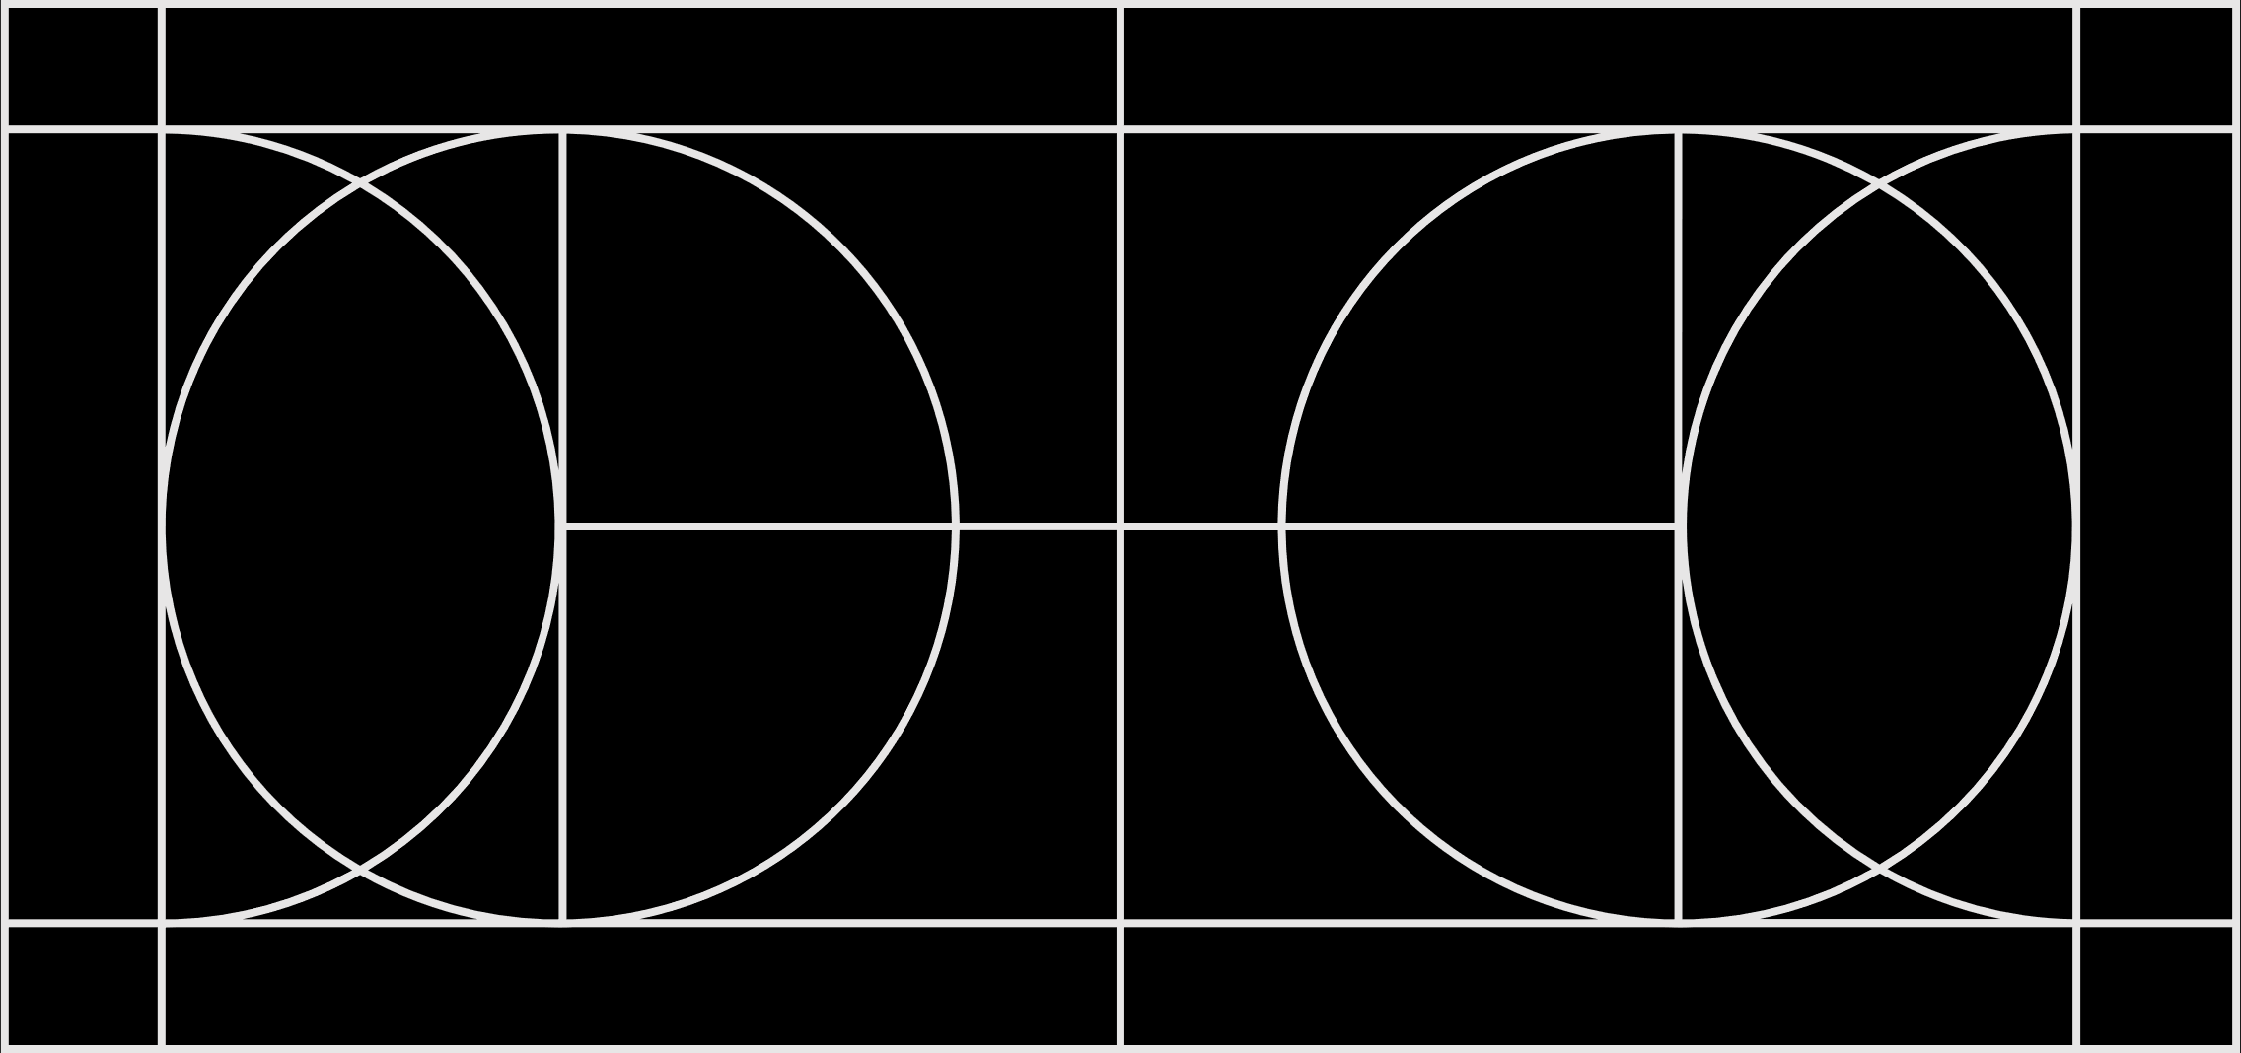
Conclusion:
$$X_{n}\underset{→}{a.s.}P$$
𝑋_𝑛 →┴(𝑎.𝑠.) 𝑃
$$X_{n}\underset{→}{p}P$$
𝑋_𝑛 →┴𝑝 𝑃
$$X_{n}\underset{→}{d}X$$
𝑋_𝑛 →┴𝑑 𝑋

Slide 17
Shiny App ConvergenceConcepts
This is a Shiny app for visualizing convergence almost surely, in probability and in distribution.
You will need to have the following packages installed:
After installing these, you can run the app from the R console using:
install.packages(c(“shiny”,”ConvergenceConcepts”,”shinydashboard”))
library(“shinydashboard”)
library(“shiny”)
library(“ConvergenceConcepts”)
library(“XiaoxiaChampon/ConvergenceConcepts”)

Slide 18
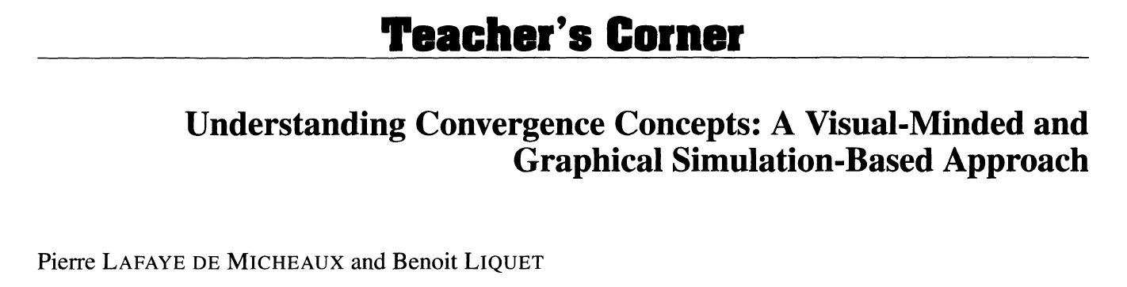
References
Article
Understanding Convergence Concepts
The content of this article:
https://www-jstor-org.prox.lib.ncsu.edu/stable/25652246?Search=yes&resultItemClick=true&searchText=convergence&searchText=concepts&searchUri=%2Faction%2FdoBasicSearch%3FQuery%3Dconvergence%2Bconcepts%26amp%3Bacc%3Don%26amp%3Bwc%3Don%26amp%3Bfc%3Doff%26amp%3Bgroup%3Dnone&ab_segments=0%2Fbasic_SYC-5187%2Fcontrol&refreqid=search%3A3f60b13a177c75f2e134ca378d3ef6bc&seq=1#metadata_info_tab_contents

Slide 19
Questions?

